Slide 1
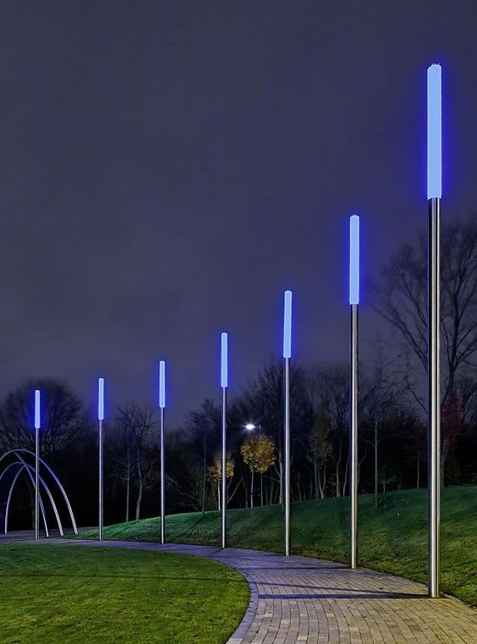
INTELLIGENT AND WEATHER ADAPTIVE STREET LIGHTING SYSTEM
T.RASHMIKA
D.SUMA BALA
D.A.VINEELA

Slide 2
PROBLEM STATEMENT
The smart street lighting controls the luminosity of light to reduce energy consumption. The turning on and turning off of street lights can be controlled based on illumination and the weather conditions. Logically, this system may save a large amount of the electrical power.

Slide 3
SOFTWARE
Arduino IDE
IBM Cloud platform

Slide 4
HARDWARE COMPONENTS
ESP8266 12E module
NRF modules
Arduino Uno
Led ’s
LDR

Slide 5
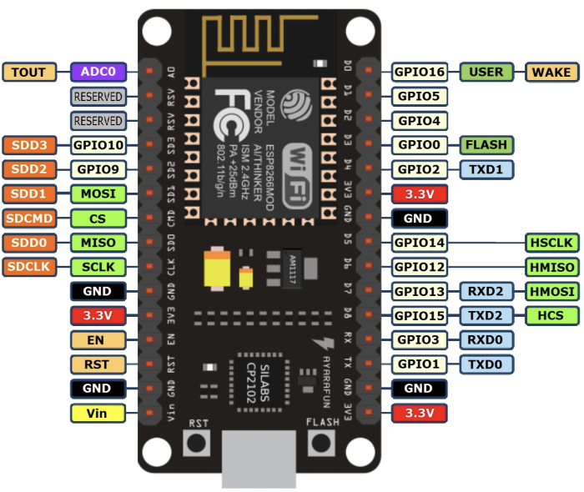
NODE MCU 1.0
Developer : ESP8266 Opensource Community CPU : ESP8266 Memory : 128kBytes Storage : 4MBytes Power By : USB Power Voltage : 3v ,5v (used with 3.3v Regulator which inbuilt on Board using Pin VIN) IDE Used : Arduino IDE GPIO : 10

Slide 6
ARDUINO UNO
Microcontroller: ATmega328.
Operating Voltage: 5V.
Input Voltage : 7-12V.
Input Voltage : 6-20V.
Digital I/O Pins: 14 (of which 6 provide PWM output)
Analog Input Pins: 6.
DC Current per I/O Pin: 40 mA.
DC Current for 3.3V Pin: 50 mA.

Slide 7
NRF24L01 module
2.4GHz RF transceiver Module
Operating Voltage: 3.3V
Nominal current: 50mA
Range : 50 – 200 feet
Operating current: 250mA (maximum)
Communication Protocol: SPI
Baud Rate: 250 kbps - 2 Mbps.

Slide 8
LDR-Light Dependent Register
This resistor works on the principle of photo conductivity. It is nothing but, when the light falls on its surface, then the material conductivity reduces

Slide 9
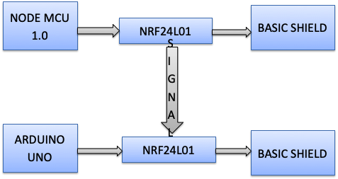
BLOCK DIAGRAM
NODE MCU 1.0
NODE MCU 1.0
NRF24L01
NRF24L01
BASIC SHIELD
BASIC SHIELD
ARDUINO UNO
ARDUINO UNO
NRF24L01
NRF24L01
BASIC SHIELD
BASIC SHIELD
SIGNAL
SIGNAL

Slide 10
WORKING
We are creating a mesh network with the NRF modules so that if one street light which acts as coordinator is made ON then automatically the other street lights which are acting as routers will also receive data from the main module and switch on the street lights which are present there. From this router the data will be transmitted to other router and process will be continued.

Slide 11
ADVANTAGES
There are lower chances of the automatic street light system overheating & risk of accidents is also minimized.
Cost of operating automatic street lights is far less when compared to the conventional street lights.
The emission of co₂ is reduced .
The light pollution is reduced.
The cost significantly reduced because sodium vapour lamps are replaced by LED.
Communication is made wireless.
Man power is entirely eliminated.

